Slide 1
Deep Learning for Biology
Joris Roels

Slide 2
Neural Networks

Slide 3
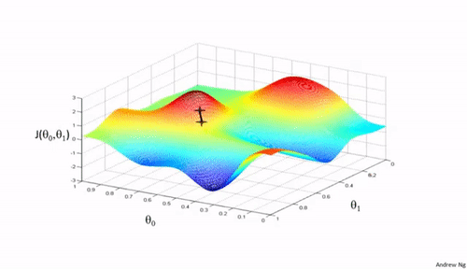
















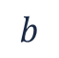


Overview
$x_{1}$
$$w_{1}$$
$x_{2}$
$$w_{2}$$
$$y$$
$$…$$
Introduction
Perceptrons
Multi-layer Perceptrons
Training an MLP
Tips & Tricks
Exercises
$$w_{n}$$
$x_{n}$
$$b$$
$x_{1}$
$h_{1}$
$y_{1}$
$x_{2}$
$h_{2}$
$y_{2}$
$$…$$
$$…$$
$$…$$
$x_{n}$
$h_{m}$
$y_{l}$

Slide 4
Introduction

Slide 5
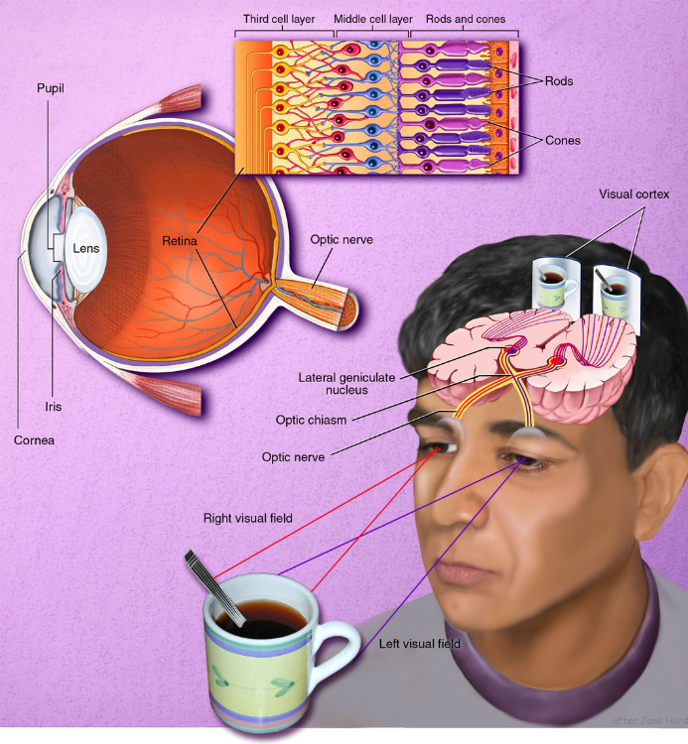
The Human Visual System
Visual perception:
Light from an object enters the eye
A lens focuses the light onto the retina
Photoreceptors (rods & cones) convert light in electrochemical signals
Signals are sent to a second and third layer in the retina
⇒ Contrast detection
Signal is further transferred to the primary visual cortex in a layer-wise fashion to interpret the image

Slide 6
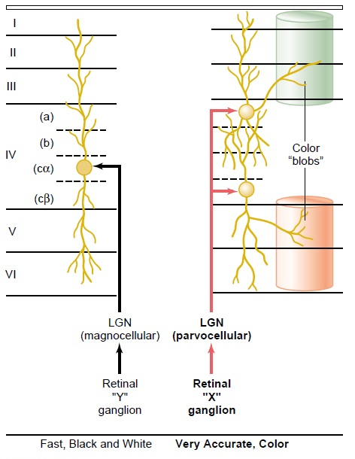
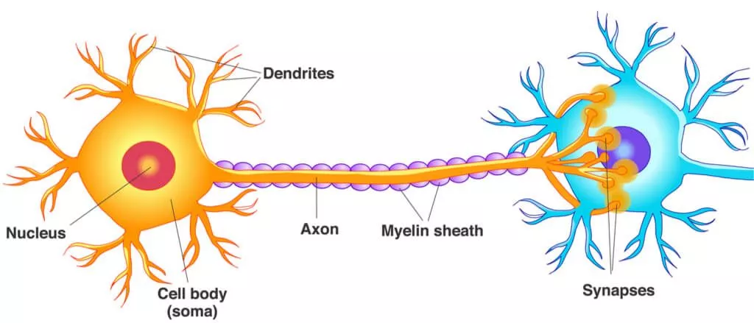
Primary Visual Cortex
Structure:
Consists of brain cells (neurons)
Sparsely connected by axons
Structured in “layers”

Slide 7
Perceptrons

Slide 8
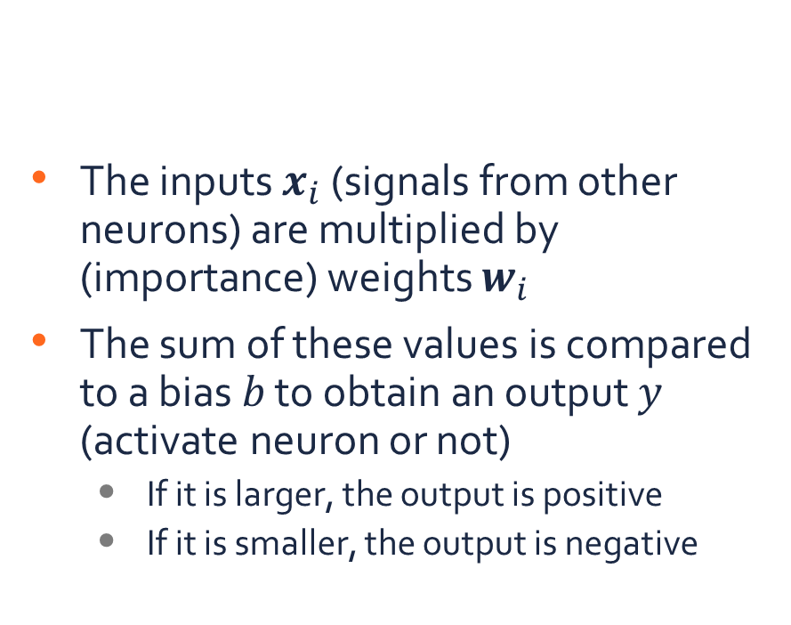






Perceptron
The inputs $x_{i}$ (signals from other neurons) are multiplied by (importance) weights $w_{i}$
The sum of these values is compared to a bias $b$ to obtain an output $y$ (activate neuron or not)
If it is larger, the output is positive
If it is smaller, the output is negative
Mathematical formalization of an artificial neuron cell (Rosenblatt, 1958)
$x_{1}$
$$w_{1}$$
$x_{2}$
$$w_{2}$$
$$y$$
$$…$$
$$w_{n}$$
$x_{n}$
$$b$$

Slide 9
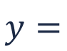
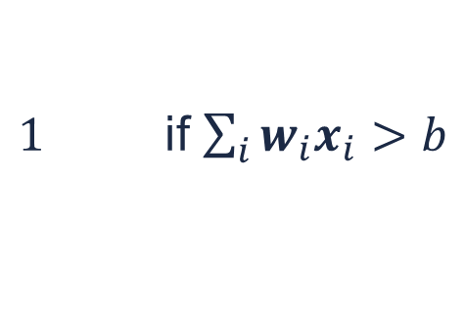
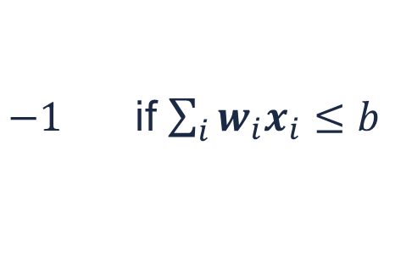
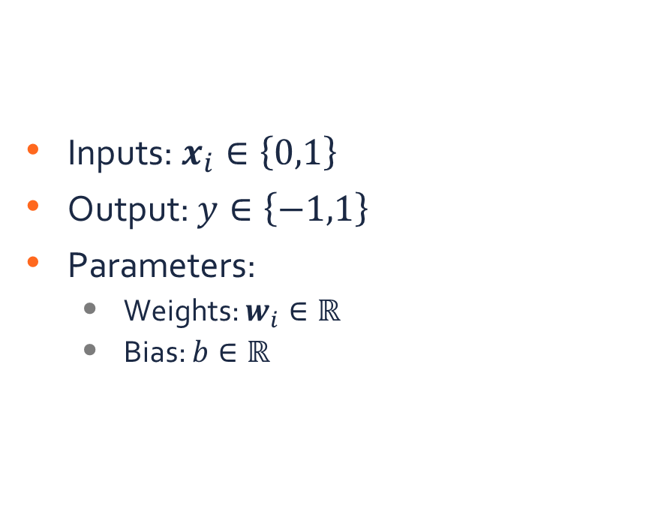
Perceptron
Inputs: $x_{i}∈\left\{0,1\right\}$
Output: $y∈\left\{−1,1\right\}$
Parameters:
Weights: $w_{i}∈ℝ$
Bias: $b∈ℝ$
Mathematical formalization of an artificial neuron cell (Rosenblatt, 1958)
$x_{1}$
$$w_{1}$$
$x_{2}$
$$w_{2}$$
$$y$$
$$…$$
$$w_{n}$$
$−1$ if $\sum_{i}{w_{i}x_{i}}≤b$
$x_{n}$
$$y=$$
$1$ if $\sum_{i}{w_{i}x_{i}}>b$
$$b$$

Slide 10
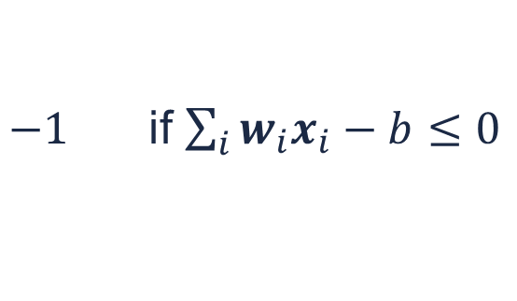
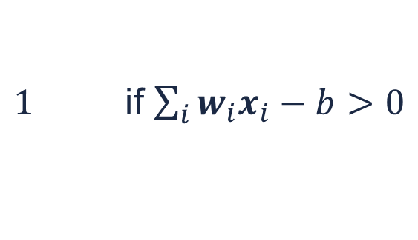
Perceptron
Inputs: $x_{i}∈\left\{0,1\right\}$
Output: $y∈\left\{−1,1\right\}$
Parameters:
Weights: $w_{i}∈ℝ$
Bias: $b∈ℝ$
Mathematical formalization of an artificial neuron cell (Rosenblatt, 1958)
$x_{1}$
$$w_{1}$$
$x_{2}$
$$w_{2}$$
$$y$$
$$…$$
$$w_{n}$$
$−1$ if $\sum_{i}{w_{i}x_{i}}−b≤0$
$x_{n}$
$$y=$$
$1$ if $\sum_{i}{w_{i}x_{i}}−b>0$
$$b$$

Slide 11
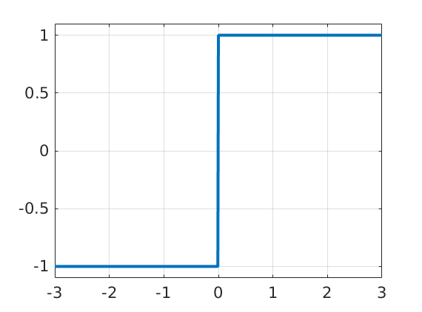
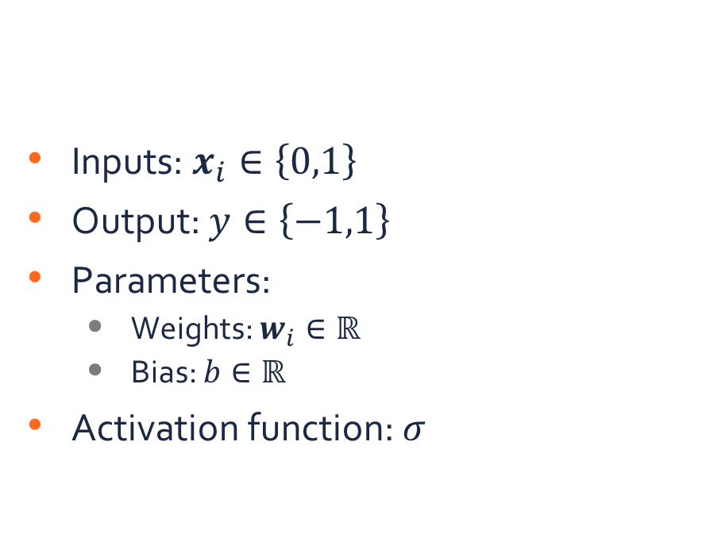

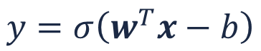



Perceptron
Inputs: $x_{i}∈\left\{0,1\right\}$
Output: $y∈\left\{−1,1\right\}$
Parameters:
Weights: $w_{i}∈ℝ$
Bias: $b∈ℝ$
Activation function: $σ$
Mathematical formalization of an artificial neuron cell (Rosenblatt, 1958)
$x_{1}$
$$w_{1}$$
$x_{2}$
$$w_{2}$$
$$y$$
$$…$$
$$w_{n}$$
$x_{n}$
$$y=σ\left(w^{T}x−b\right)$$
$$b$$
$$=$$
$$=$$
$$x$$
$$w$$

Slide 12
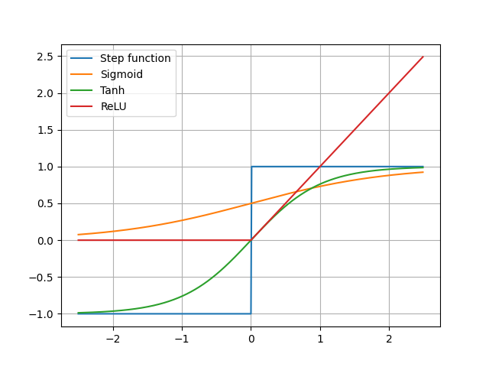
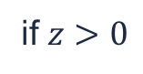
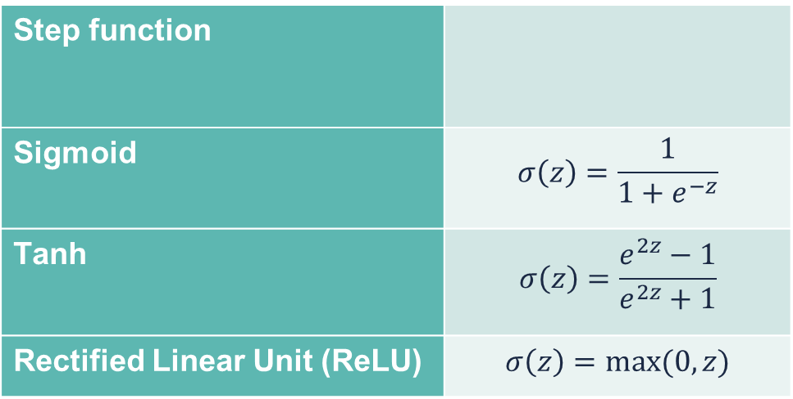
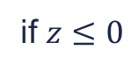

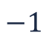

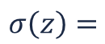
Activation functions
Activate functions can be any non-linear, differentiable function
Step function
Sigmoid | $$σ\left(z\right)=\frac{1}{1+e^{−z}}$$
Tanh | $$σ\left(z\right)=\frac{e^{2z}−1}{e^{2z}+1}$$
Rectified Linear Unit (ReLU) | $$σ\left(z\right)=max⁡(0,z)$$
$$−1$$
if $z≤0$
$$σ\left(z\right)=$$
$$1$$
if $z>0$
Nair & Hinton, 2010
$$z$$

Slide 13





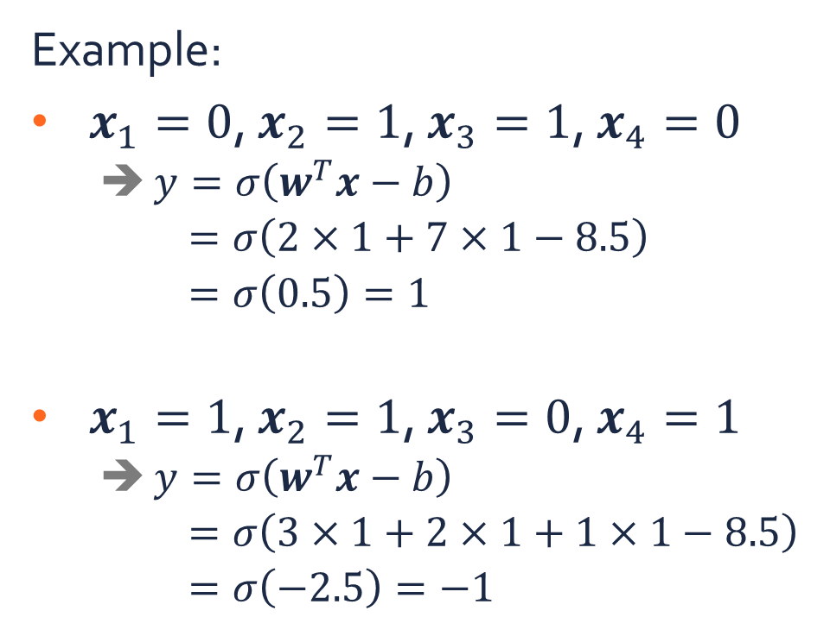




Perceptron
Example:
$x_{1}=0$, $x_{2}=1$, $x_{3}=1$, $x_{4}=0$
$y=σ\left(w^{T}x−b\right)$
$=σ\left(2×1+7×1−8.5\right)$
$=σ\left(0.5\right)=1$
$x_{1}=1$, $x_{2}=1$, $x_{3}=0$, $x_{4}=1$
$y=σ\left(w^{T}x−b\right)$
$=σ\left(3×1+2×1+1×1−8.5\right)$
$=σ\left(−2.5\right)=−1$
$x_{1}$
$$3$$
$x_{2}$
$$2$$
$$y$$
$$7$$
$x_{3}$
$$1$$
$x_{4}$
$$8.5$$

Slide 14




Perceptron
Multiple outputs
$x_{1}$
$$w_{1}$$
$x_{2}$
$$w_{2}$$
$$y$$
$$…$$
$$w_{n}$$
$x_{n}$
$$b$$
$$=$$
$$=$$
$$x$$
$$w$$

Slide 15
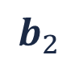

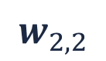
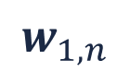

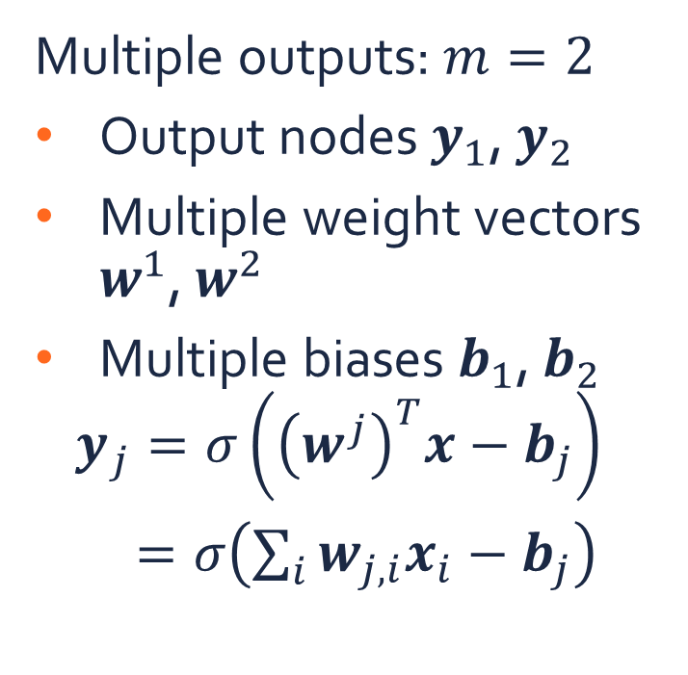
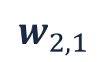
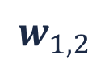


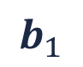
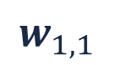

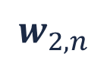
Perceptron
Multiple outputs: $m=2$
Output nodes $y_{1}$, $y_{2}$
Multiple weight vectors $w^{1}$, $w^{2}$
Multiple biases $b_{1}$, $b_{2}$
$$y_{j}=σ\left({\left(w^{j}\right)}^{T}x−b_{j}\right)$$
$=σ\left(\sum_{i}{w_{j,i}x_{i}}−b_{j}\right)$
$$b_{1}$$
$x_{1}$
$$w_{1,1}$$
$$w_{2,1}$$
$$y_{1}$$
$x_{2}$
$$w_{1,2}$$
$$w_{2,2}$$
$$…$$
$$w_{1,n}$$
$$w_{2,n}$$
$$y_{2}$$
$x_{n}$
$$=$$
$$=$$
$$=$$
$$x$$
$$w^{1}$$
$$w^{2}$$
$$b_{2}$$

Slide 16


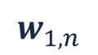

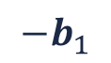



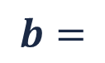
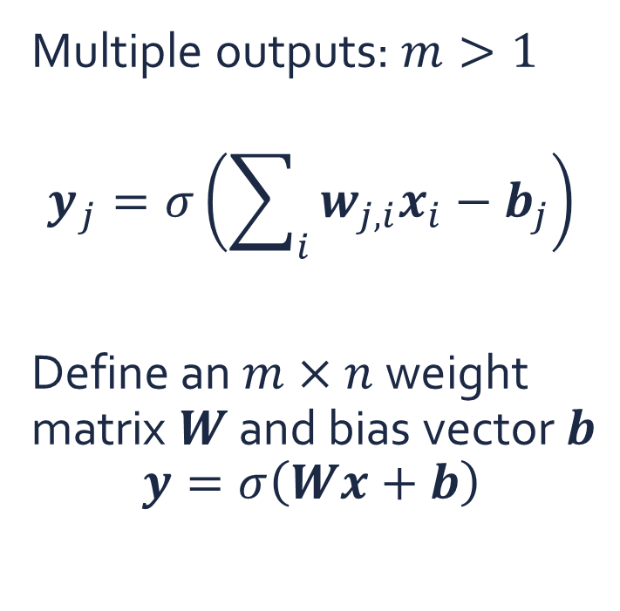

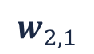

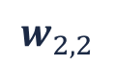



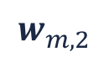
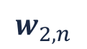


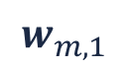


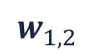



Perceptron
$$w_{1,1}$$
$$w_{1,2}$$
$$…$$
$$w_{1,n}$$
$${−b}_{1}$$
$$w_{2,1}$$
$$w_{2,2}$$
$$…$$
$$w_{2,n}$$
$${−b}_{2}$$
$$W=$$
$$…$$
$$…$$
$$…$$
$$…$$
$$b=$$
$$…$$
Multiple outputs: $m>1$
$$y_{j}=σ\left(\sum_{i}{w_{j,i}x_{i}}−b_{j}\right)$$
Define an $m×n$ weight matrix $W$ and bias vector $b$
$$y=σ\left(Wx+b\right)$$
$$w_{m,1}$$
$$w_{m,2}$$
$$…$$
$$w_{m,n}$$
$${−b}_{m}$$
$x_{1}$
$y_{1}$
$x_{2}$
$y_{2}$
$$…$$
$$…$$
$x_{n}$
$y_{m}$
$$=$$
$$=$$
$$x$$
$$y$$

Slide 17
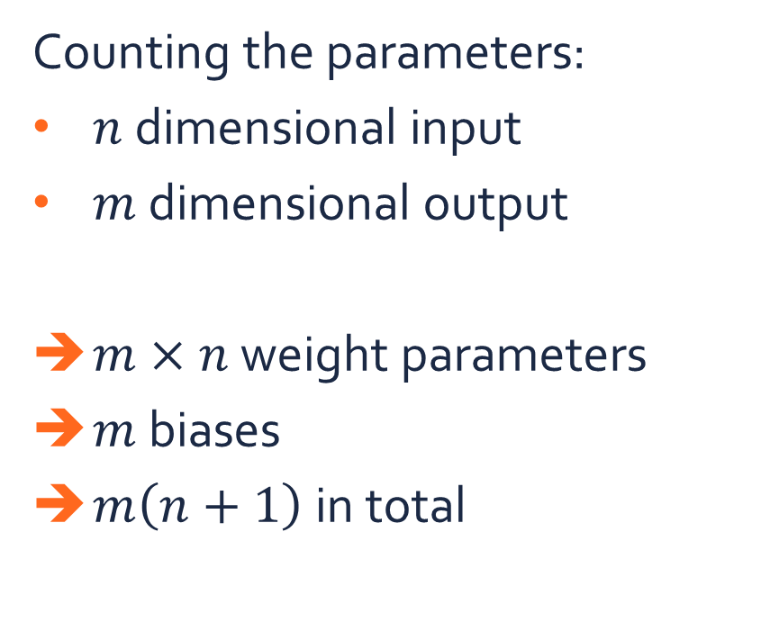
Perceptron
Counting the parameters:
$n$ dimensional input
$m$ dimensional output
$m×n$ weight parameters
$m$ biases
$m\left(n+1\right)$ in total
$x_{1}$
$y_{1}$
$x_{2}$
$y_{2}$
$$…$$
$$…$$
$x_{n}$
$y_{m}$
$$=$$
$$=$$
$$x$$
$$y$$

Slide 18
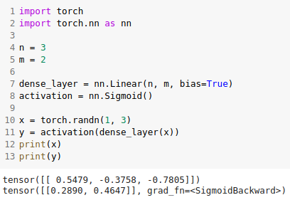

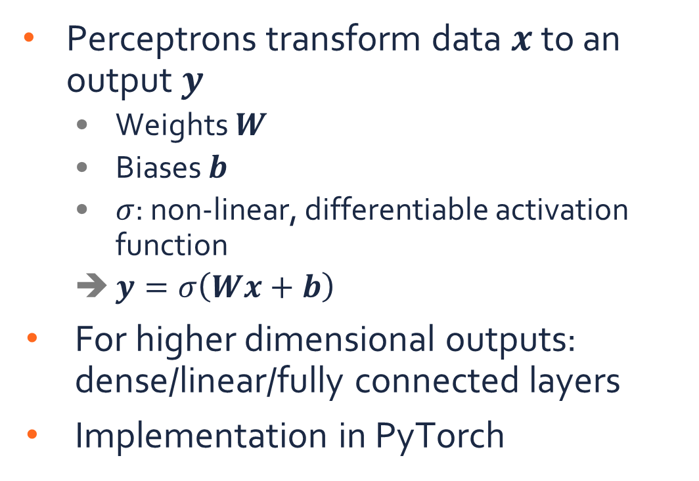


Summary
$x_{1}$
$y_{1}$
$x_{2}$
$y_{2}$
Perceptrons transform data $x$ to an output $y$
Weights $W$
Biases $b$
$σ$: non-linear, differentiable activation function
$y=σ\left(Wx+b\right)$
For higher dimensional outputs: dense/linear/fully connected layers
Implementation in PyTorch
$$…$$
$$…$$
$x_{n}$
$y_{m}$

Slide 19
Multi-layer perceptrons

Slide 20


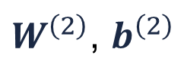
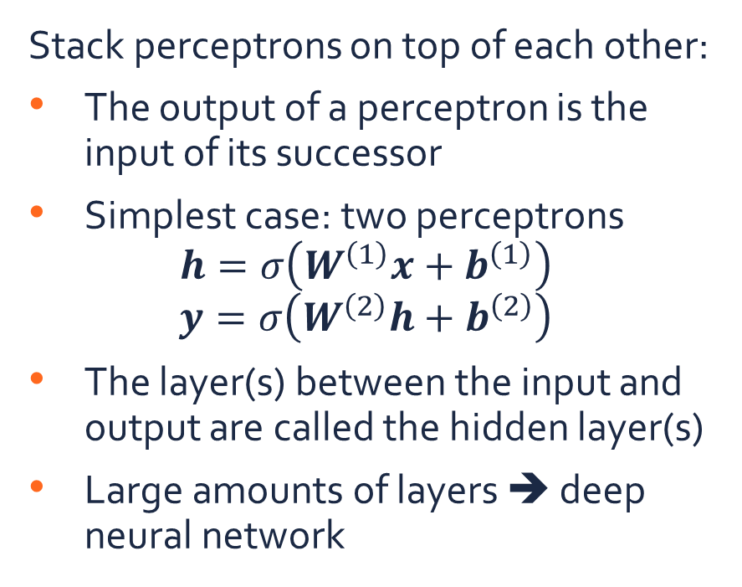
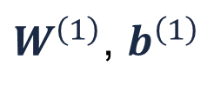




Multi-layer perceptrons
Stack perceptrons on top of each other:
The output of a perceptron is the input of its successor
Simplest case: two perceptrons
$$h=σ\left(W^{\left(1\right)}x+b^{\left(1\right)}\right)$$
$$y=σ\left(W^{\left(2\right)}h+b^{\left(2\right)}\right)$$
The layer(s) between the input and output are called the hidden layer(s)
Large amounts of layers ➔ deep neural network
$W^{\left(1\right)}$, $b^{\left(1\right)}$
$W^{\left(2\right)}$, $b^{\left(2\right)}$
$x_{1}$
$h_{1}$
$y_{1}$
$x_{2}$
$h_{2}$
$y_{2}$
$$…$$
$$…$$
$$…$$
$x_{n}$
$h_{m}$
$y_{l}$

Slide 21


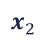

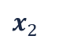


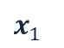















Multi-layer perceptrons
(c) MLP
Motivation:
Multiple consecutive layers increase the capacity of a network
Example: binary classification in 2D data
(a) Linear classifier
(b) Perceptron
$y$
$y$
$y$
$h_{1}$
$h_{2}$
$$…$$
$h_{m}$
$x_{1}$
$x_{1}$
$x_{2}$
$x_{2}$
$x_{1}$
$x_{2}$
$x_{2}$
Observed positive samples ($y=1$)
$x_{2}$
$x_{2}$
$x_{2}$
Observed negative samples ($y=−1$)
$x_{1}$
$x_{1}$
$x_{1}$
$x_{1}$

Slide 22
Training an MLP

Slide 23



MLP for classification
$W^{\left(1\right)}$, $b^{\left(1\right)}$
$W^{\left(2\right)}$, $b^{\left(2\right)}$
For the sake of notational simplicity, we will consider an MLP with a single hidden layer for classification ($l$ classes)
➔ $y=σ\left(W^{\left(2\right)}\left(σ\left(W^{\left(1\right)}x+b^{\left(1\right)}\right)\right)+b^{\left(2\right)}\right)$
$=f_{θ}\left(x\right)$
$$θ=\left\{W^{\left(1\right)},b^{\left(1\right)},W^{\left(2\right)},\right\}$$
$x_{1}$
$h_{1}$
$y_{1}$
$x_{2}$
$h_{2}$
$y_{2}$
$$…$$
$$…$$
$$…$$
$x_{n}$
$h_{m}$
$y_{l}$

Slide 24

One-hot encoding
The output of a classification MLP is a probability distribution over the classes:
$$f_{θ}\left(x\right)=y$$
➔ $y_{c}$: probability that the sample $x$ belongs to class $c$
$x_{1}$
$h_{1}$
$y_{1}$
$x_{2}$
$h_{2}$
$y_{2}$
$$…$$
$$…$$
$$…$$
$x_{n}$
$h_{m}$
$y_{l}$

Slide 25




One-hot encoding
The output of a classification MLP is a probability distribution over the classes:
$$f_{θ}\left(x\right)=y$$
➔ $y_{c}$: probability that the sample $x$ belongs to class $c$
One-hot encoding of a class label
$$3⟷\left(0,0,1,0\right)$$
Output of an MLP
$$\left(0.05,0.1,0.8,0.05\right)$$
1
1
$$l=4$$
0
0
Class 1
Class 2
Class 3
Class 1
Class 2
Class 4
Class 3
Class 4

Slide 26
Propagation
Forward propagation
So far, we have only seen how to compute the output of a given network architecture with fixed weights ➔ Forward propagation
How do we learn the values of the weights?
Loss function
Optimization ➔ Backward propagation
$x_{1}$
$h_{1}$
$y_{1}$
$x_{2}$
$h_{2}$
$y_{2}$
$$…$$
$$…$$
$$…$$
$x_{n}$
$h_{m}$
$y_{l}$
Backward propagation

Slide 27


Loss function
A loss function $ℒ\left(\hat{y},y\right)$ expresses how “close” the prediction $\hat{y}$ of an MLP is, compared to the ground truth $y$
Given a training dataset
$𝒟=\left\{\left(x^{\left(i\right)},y^{\left(i\right)}\right)|i=1,…,N\right\}$
we aim to find parameters $θ$ of the MLP that minimize $ℒ$ over the complete dataset:
$$θ^{∗}=\arg{\min_{θ}{\frac{1}{N}\sum_{i}{ℒ\left(f_{θ}\left(x^{\left(i\right)}\right),y^{\left(i\right)}\right)}}}$$

Slide 28




Loss function
Example: Cross entropy
$$ℒ\left(\hat{y},y\right)=−\sum_{c}{y_{c}\log{{\hat{p}}_{c}}}$$
$${\hat{p}}_{c}=\frac{\exp{{\hat{y}}_{c}}}{\sum_{c}{\exp{{\hat{y}}_{c}}}}$$
The output of an MLP is not necessarily a probability distribution
${\hat{y}}_{c}$: logits
${\hat{p}}_{c}$: class probabilities
Use a softmax transformation to normalize the output to [0,1] values that sum to 1
Tends to push logits to either 0 or 1
$$\exp{{\hat{y}}_{c}}$$
$${\hat{y}}_{c}$$

Slide 29




Loss function
Example: Cross entropy
$$ℒ\left(\hat{y},y\right)=−\sum_{c}{y_{c}\log{{\hat{p}}_{c}}}$$
$${\hat{p}}_{c}=\frac{\exp{{\hat{y}}_{c}}}{\sum_{c}{\exp{{\hat{y}}_{c}}}}$$
For a sample of class $c′$, $y_{c}$ will always be zero, except for $c=c′$ (one-hot encoding)
For that particular term, the loss is equal to $−\log{{\hat{p}}_{c}}$:
For $c=c′$, ${\hat{p}}_{c}$ (and ${\hat{y}}_{c}$) is forced to be high
For $c≠c′$, ${\hat{p}}_{c}$ (and ${\hat{y}}_{c}$) is forced to be low, as the sum over all class predictions should be 1
Loss
$$−\log{{\hat{p}}_{c}}$$
$${\hat{p}}_{c}$$

Slide 30



Loss function
1
Example:
$y=\left(0,1,0\right)$
$\hat{y}=\left(0.5,−1,1.5\right)$
$\hat{p}=\frac{1}{\exp\left(0.5\right)+\exp\left(−1\right)+\exp\left(1.5\right)}\left[\exp\left(0.5\right),\exp\left(−1\right),\exp\left(1.5\right)\right]$
$≈\left[0.25,0.06,0.69\right]$
$ℒ\left(\hat{y},y\right)=−\left(0×\log\left(0.25\right)+1×\log\left(0.06\right)+0×\log\left(0.69\right)\right)$
$≈2.81$
$$y$$
0
Class 0
Class 1
Class 2
1
$$\hat{p}$$
0
Class 0
Class 1
Class 2

Slide 31

Loss function
1
Example:
$y=\left(1,0,0\right)$
$\hat{y}=\left(1.2,−0.1,−5\right)$
$\hat{p}=\frac{1}{\exp\left(1.2\right)+\exp\left(−0.1\right)+\exp\left(−5\right)}\left[\exp\left(1.2\right),\exp\left(−0.1\right),\exp\left(−5\right)\right]$
$≈\left[0.78,0.21,0.01\right]$
$ℒ\left(\hat{y},y\right)=−\left(1×\log\left(0.78\right)+0×\log\left(0.21\right)+0×\log\left(0.01\right)\right)$
$≈0.25$
$$y$$
0
Class 0
Class 1
Class 2
1
$$\hat{p}$$
0
Class 0
Class 1
Class 2

Slide 32


Loss function
Example: Weighted cross entropy
$$ℒ\left(\hat{y},y\right)=−\sum_{c}{w_{c}y_{c}\log{{\hat{p}}_{c}}}$$
$${\hat{p}}_{c}=\frac{\exp{{\hat{y}}_{c}}}{\sum_{c}{\exp{{\hat{y}}_{c}}}}$$
Assign a weighting parameter $w_{c}$ to each class to specify the importance of a class
Useful for imbalanced data
Implementation in PyTorch

Slide 33



Loss function
A loss function $ℒ\left(\hat{y},y\right)$ expresses how “close” the prediction $\hat{y}$ of an MLP is, compared to the ground truth $y$.
Given a training dataset
$𝒟=\left\{\left(x^{\left(i\right)},y^{\left(i\right)}\right)|i=1,…,N\right\}$
we aim to find parameters $θ$ of the MLP that minimize $ℒ$ over the complete dataset:
$$θ^{∗}=\arg{\min_{θ}{\sum_{i}{ℒ\left(f_{θ}\left(x^{\left(i\right)}\right),y^{\left(i\right)}\right)}}}$$
Training data $𝒟$
How do we minimize this loss?

Slide 34







Gradient descent
For a function $g\left(θ\right)$ with scalar inputs, we aim to find the minimum:
$$θ^{∗}=\arg{\min_{θ}{g\left(θ\right)}}$$
Gradient descent:
Pick a starting point $θ^{∗}$
Repeat until convergence:
Compute $\frac{dg}{dθ}\left(θ^{∗}\right)=g^{′}\left(θ^{∗}\right)$
Set $θ^{∗}←θ^{∗}−αg^{′}\left(θ^{∗}\right)$
$$g\left(θ\right)$$
$$g^{′}\left(θ^{∗}\right)$$
$$−αg^{′}\left(θ^{∗}\right)$$
$$θ$$
Learning rate
$$θ^{∗}−αg^{′}\left(θ^{∗}\right)$$
$$θ^{∗}$$

Slide 35




Gradient descent
For a function $g\left(θ\right)$ with vector inputs, we aim to find the minimum:
$$θ^{∗}=\arg{\min_{θ}{g\left(θ\right)}}$$
Gradient descent:
Pick a starting point $θ^{∗}$
Repeat until convergence:
Compute ${\left(\frac{∂g}{∂θ_{i}}\left(θ^{∗}\right)\right)}_{i}=∇_{θ}g\left(θ^{∗}\right)$
Set $θ^{∗}←θ^{∗}−α∇_{θ}g\left(θ^{∗}\right)$
$$g\left(θ\right)$$
$$θ_{2}$$
$$θ_{1}$$
Learning rate

Slide 36

Gradient descent
We aim to solve
$$θ^{∗}=\arg{\min_{θ}{E\left(θ\right)}}=\arg{\min_{θ}{\sum_{i}{ℒ\left(f_{θ}\left(x^{\left(i\right)}\right),y^{\left(i\right)}\right)}}}$$
for all samples $\left(x^{\left(i\right)},y^{\left(i\right)}\right)$ in the training dataset
Gradient descent:
Pick a starting point $θ^{∗}$ (initialize the parameters)
Repeat until convergence:
Compute $∇_{θ}E\left(θ^{∗}\right)=\sum_{i}{∇_{θ}ℒ\left(f_{θ}\left(x^{\left(i\right)}\right),y^{\left(i\right)}\right)}$ (backpropagation)
Set $θ^{∗}←θ^{∗}−α∇_{θ}E\left(θ^{∗}\right)$ (update the parameters)

Slide 37



Stochastic gradient descent
Training data $𝒟$
Computing
$$∇_{θ}E\left(θ^{∗}\right)=\sum_{i=1}^{N}{∇_{θ}ℒ\left(f_{θ}\left(x^{\left(i\right)}\right),y^{\left(i\right)}\right)}$$
in each gradient descent step requires too much time
We assume that the training dataset is large
Approximate the gradient on a randomly selected minibatch of training samples:
$$ℬ=\left\{\left(x^{\left(i_{j}\right)},y^{\left(i_{j}\right)}\right)|j=1,…,B;B≪N\right\}⊂𝒟$$
Stochastic gradient descent (SGD)
$$∇_{θ}E\left(θ^{∗}\right)≈\sum_{j=1}^{B}{∇_{θ}ℒ\left(f_{θ}\left(x^{\left(i_{j}\right)}\right),y^{\left(i_{j}\right)}\right)}$$
Where $B$ is the batch size
Minibatch $ℬ$

Slide 38








Stochastic gradient descent
$$g\left(θ\right)$$
Remarks:
Gradient descent converges to a local minimum (not global!) in general
Learning rate $α$ should be carefully selected
Small learning rates lead to slow convergence
Large learning rates can overshoot the minimum
Batch size $B$ should be carefully selected
Small batch sizes introduce noisy gradient estimates
Large batch sizes lead to slow convergence
$$θ$$
$$g\left(θ\right)$$
$$θ$$

Slide 39


Stochastic gradient descent
Remarks:
Gradient descent converges to a local minimum (not global!) in general
Learning rate $α$ should be carefully selected
Small learning rates lead to slow convergence
Large learning rates can overshoot the minimum
Batch size $B$ should be carefully selected
Small batch sizes introduce noisy gradient estimates
Large batch sizes lead to slow convergence
Implementation in PyTorch

Slide 40


MLP training
repeat:
for each batch $ℬ$ in $𝒟$:
for each ($x^{\left(i_{j}\right)}$, $y^{\left(i_{j}\right)}$) in $ℬ$:
${\hat{y}}^{\left(i_{j}\right)}=f_{\hat{θ}}\left(x^{\left(i_{j}\right)}\right)$ # forward propagation
$L^{\left(i_{j}\right)}=ℒ\left({\hat{y}}^{\left(i_{j}\right)},y^{\left(i_{j}\right)}\right)$ # compute loss
$∇_{θ}E≈\sum_{j=1}^{B}{∇_{θ}L^{\left(i_{j}\right)}}$ # backward propagation
for each parameter ${\hat{θ}}_{k}$ in $\hat{θ}$:
${\hat{θ}}_{k}←{\hat{θ}}_{k}−α∇_{{\hat{θ}}_{k}}E$ # parameter update
until convergence

Slide 41

Alternative optimization algorithms
Most optimization algorithms for neural networks are gradient-based:
Adagrad (Duchi et.al., 2011)
Adadelta (Zeiler, 2012)
RMSProp (Tieleman & Hinton, 2012)
Adam (Kingma et.al., 2015)
…

Slide 42
Tips & Tricks

Slide 43



Batch normalization
Test accuracy on MNIST
Internal covariate shift: the distribution of the activations change vary significantly between different minibatches
Batch normalization (Ioffe & Szegedy, 2015):
Normalize the activations to zero mean and unit variance:
$$h_{i}←\frac{h_{i}−μ_{h}}{σ_{h}}$$
Introduce learnable parameters that re-adjust the distribution properly:
$$h_{i}←γ_{i}h_{i}+β_{i}$$
Can significantly accelerate & stabilize training
Implementation in PyTorch

Slide 44







Dropout
$$h_{i}→0$$
$x_{1}$
$h_{1}$
$y_{1}$
MLPs tend to overfit on the train set by using the same activation paths
Dropout (Srivastava et.al., 2014):
During training: randomly switch off a fraction $p$ of the neurons in layer(s)
During testing: all neurons switched on
No dropout in the output layer!
Forces the network to use alternative paths for decision making and reduces overfitting
Implementation in PyTorch
$x_{2}$
$h_{2}$
$y_{2}$
$$…$$
$$…$$
$$…$$
$x_{n}$
$h_{m}$
$y_{l}$

Slide 45


Adaptive learning rate
As we get closer to the minimum, the learning rate should be decreased
Examples:
Linear decay: $α^{\left(t\right)}=α^{\left(0\right)}+tε$
Multiplicative decay: $α^{\left(t\right)}=γ^{t}α^{\left(0\right)}$
Reduce learning rate on plateau
Implementation in PyTorch

Slide 46


Momentum
Gradient updates can be noisy, e.g. with large learning rates
Make the gradient update dependent on one or more previous updates
$δ\left(t\right)$: gradient in iteration $t$
$δ\left(t+1\right)←δ\left(t+1\right)+μδ\left(t\right)$
Allows to get through plateaus due to the obtained “momentum”
Without momentum
With momentum

Slide 47

Early stopping
Divide data in train, test and validation set
Train the model on the train data
Select the model with the best validation performance
Finally, test the model on the test set

Slide 48
Summary
$x_{1}$
$$w_{1}$$
$x_{2}$
$$w_{2}$$
$$y$$
$$…$$
Perceptron:
Mathematical formalization of neurons
Input-output mapping by matrix multiplication and non-linear activation
Multi-layer perceptron (MLP):
Stacked perceptrons increase the capacity of the network
Training:
Loss function: cross entropy (classification)
Optimization: stochastic gradient descent (SGD)
Tips & tricks:
Architectural: Batch normalization, dropout
Training: Adaptive learning rate, momentum, early stopping
$$w_{n}$$
$x_{n}$
$$b$$
$x_{1}$
$h_{1}$
$y_{1}$
$x_{2}$
$h_{2}$
$y_{2}$
$$…$$
$$…$$
$$…$$
$x_{n}$
$h_{m}$
$y_{l}$

Slide 49
Exercises

Slide 50





Deep learning frameworks
There exist many frameworks for deep learning (mostly Python)
PyTorch
TensorFlow
Keras
Caffe
Theano
…

Slide 51

Machine learning framework
GPU acceleration: alternative for numpy
Open source
Python
Easy to install: https://pytorch.org/get-started/locally/
Large user community (especially research)
Automatic differentiation
Lots of flexibility
Lots of tutorials: https://pytorch.org/tutorials/
60-min blitz is highly advised!
Well-documented: https://pytorch.org/docs/stable

Slide 52

Google Colab
Compute environment: Google Colaboratory (Colab)
Write/execute Python code through the browser
Well suited to machine learning, data analysis and education
Jupyter notebooks
Virtual machines:
No setup required
Most drivers and Python libraries installed
Free use of resources
GPU (NVIDIA K80, T4, P4 and P100) & TPU
12 GB RAM
12 hours compute time / session
If you have question about Colab: ask us, or check the FAQ: https://research.google.com/colaboratory/faq.html

Slide 53
Exercises
Open the notebook in Google Colab:
https://colab.research.google.com/github/JorisRoels/deep-learning-biology/blob/main/exercises/assignments/2020-dlb-1-neural-networks.ipynb
Make sure you are using a GPU: Runtime > Change Runtime Type > Select ‘GPU’
Move to your break-out room
Try to solve the exercises
After every exercise we will come back to the main room and discuss the results
The complete solution notebook will be uploaded at the end of the session
Ask questions to the assistants in the break-out room!

Slide 55
References
Rosenblatt, F. (1958). The perceptron: A probabilistic model for information storage and organization in the brain. Psychological Review. https://doi.org/10.1037/h0042519
Nair, V., & Hinton, G. E. (2010). Rectified Linear Units Improve Restricted Boltzmann Machines. International Conference on Machine Learning, 3, 807–814. https://doi.org/10.1.1.165.6419
Kingma, D. P., & Ba, J. L. (2015). Adam: a Method for Stochastic Optimization. International Conference on Learning Representations, 1–15. https://doi.org/http://doi.acm.org.ezproxy.lib.ucf.edu/10.1145/1830483.1830503
Duchi, J., Hazan, E., & Singer, Y. (2011). Adaptive Subgradient Methods for Online Learning and Stochastic Optimization * Elad Hazan. In Journal of Machine Learning Research (Vol. 12, Issue 61). http://jmlr.org/papers/v12/duchi11a.html
Zeiler, M. D. (2012). ADADELTA: An Adaptive Learning Rate Method. http://arxiv.org/abs/1212.5701
Tieleman, T., & Hinton, G. (2012). Lecture 6.5 - RMSProp, COURSERA: Neural Networks for Machine Learning. Technical Report.
Ioffe, S., & Szegedy, C. (2015). Batch Normalization: Accelerating Deep Network Training by Reducing Internal Covariate Shift. In D. Blei & F. Bach (Eds.), International Conference on Machine Learning (pp. 448–456). JMLR Workshop and Conference Proceedings. https://doi.org/10.1007/s13398-014-0173-7.2
Srivastava, N., Hinton, G., Krizhevsky, A., Sutskever, I., & Salakhutdinov, R. (2014). Dropout: A simple way to prevent neural networks from overfitting. Journal of Machine Learning Research.

